Slide 1
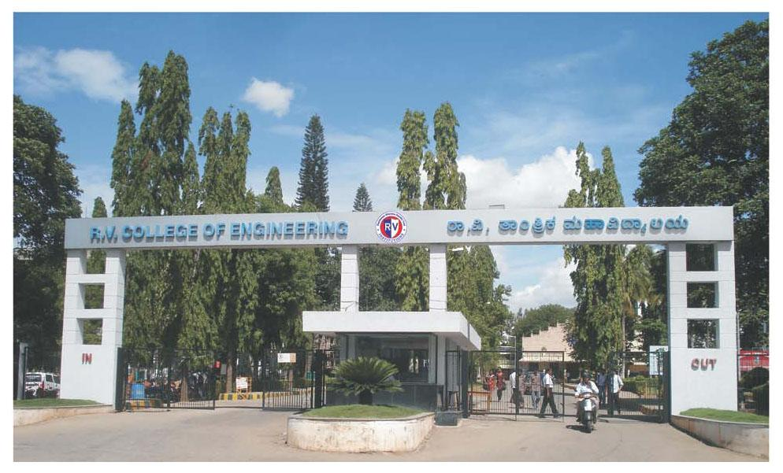
INTERDISCIPLINARY PHASE 1 PRESENTATION
Internet of Things (IOT) Powered Automated Delivery Vehicle with Robotic Arm for Smart Warehousing
Mentor - Dr. Nanjundaradhya N V, Professor
Department of Mechanical Engineering

Slide 2
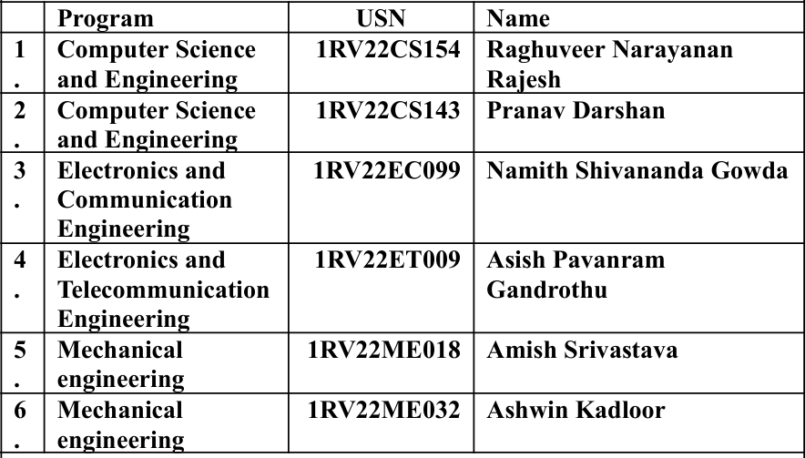
TEAM NUMBER - 166

Slide 3
INTRODUCTION
This project introduces an intelligent, internet-connected automated delivery vehicle equipped with a precision robotic arm, designed to improve efficiency in smart warehouse operations. The vehicle functions autonomously, reducing reliance on human labor for routine material handling tasks. By leveraging real-time object detection through the LLama vision model, it ensures accurate recognition and interaction with various items. This enables faster and more reliable transportation and placement of packages within dynamic warehouse environments.
The system combines robotics, machine learning, and autonomous navigation to deliver a scalable solution for modern logistics challenges. Its key application areas include smart warehousing, order fulfillment centers, and automated inventory management. The integration of advanced AI allows the vehicle to navigate obstacles, detect objects, and make decisions in real-time. Overall, it significantly enhances productivity, safety, and operational precision in industrial settings.

Slide 4
LITERATURE SURVEY
AUTHOR | PAPER TITLE | PUBLICATION DETAILS | SUMMARY
Khaled Ellithy, Mohamed Salah, Islam S. Fahim, Ahmed S. El-Tamimi | "AGV and Industry 4.0 in Warehouses: A Comprehensive Analysis of Existing Literature and an Innovative Framework for Flexible Automation" | The International Journal of Advanced Manufacturing Technology | Reviews the use of Automated Guided Vehicles (AGVs) in Industry 4.0-based warehouses. It proposes a flexible automation framework using IoT and digital twins to enhance responsiveness and scalability of logistics systems.
Aniket Gujarathi, Akshay Kulkarni, Unmesh Patil, Yogesh Phalak, Rajeshree Deotalu, Aman Jain, Navid Panchi, Ashwin Dhabale, Shital Chiddarwar | "Design and Development of Autonomous Delivery Robot” | Published on arXiv as preprint arXiv:2103.09229, 2021 | Presents the design of an autonomous robot for campus deliveries using sensors for localization and object detection. Uses a mobile base and gripper for pickup and drop-off, demonstrating feasibility for controlled environments.
Budi Hadisujoto, Ariq Naufal Rabbani, Kushendarsyah Saptaji, Nikolas Krisma Fernandez, Djati Wibowo | "Development of 3D Printed Autonomous Warehouse Robot Using Mecanum Wheel and Robot Arm" | Journal of Applied Sciences and Advanced Technology (JASAT) | Discusses a low-cost, 3D-printed prototype of an autonomous warehouse robot with mecanum wheels for omnidirectional movement and a 4-DOF robotic arm for object handling, controlled via wireless interface for warehouse tasks.
Jakub Krejčí, Marek Babiuch, Ján Babjak, Jiří Suder, Rostislav Wierbica | "Implementation of an Embedded System into the Internet of Robotic Things" | Micromachines, Volume 14, Issue 1, Article 113, 2023 | Presents a real-world implementation of embedded systems in robotic devices using IoT protocols. Focuses on enabling low-latency, high-efficiency communication in smart factories and warehouse automation systems.
Krishna Vamshi Ganduri, Bhargav Prajwal Pathri, Shivaji Rathod, Koganti Sojith, Kusuma Yanna, Bakka Shravya Reddy, Praveen Kumar Pudi | “Adaptive Intelligence in Warehouse Robotics: Efficient Pick-and-Place Robot for Dynamic Environments” | Journal of Engineering Science, Volume 13, Issue 2, 2023 | This paper presents an intelligent robotic system for dynamic warehouse automation using a 6-DOF arm, soft gripper, and PSO-based path planning for efficient, adaptive pick-and-place operations.
.

Slide 5
Ponis & Efthymiou | Cloud and IoT Applications in Material Handling Automation and Intralogistics | Logistics 2020 | RFID-tagged AGVs provide real-time status so a cloud server can coordinate fleets and optimize task allocation
Okumuş et al. | A Cloudware Architecture for Collaboration of Multiple AGVs in Indoor Logistics | Electronics 2020 | Presents an IoT/Cloud framework for coordinating multiple AGVs. A central cloud server handles heavy computations and task assignments for all vehicles.
Moufaddal et al. | A Cyber-Physical Warehouse Management System Architecture in an Industry 4.0 | A2IA Conf. 2020 | The paper outlines a unified platform where physical warehouse devices (sensors, actuators on conveyors, cranes, etc.) are Internet-connected, fusing the physical and virtual spaces.
Ellithy et al., Int. J. | AGV and Industry 4.0 in Warehouses | Advanced Manuf. Tech. 2024 | A broad literature review (111 papers, 1990–2022) on smart warehouse automation. It concludes that “combining automated machinery, collecting data technologies, and management systems” is essential for future flexible warehouses
Øvsthus et al. | Mobile Robotic Manipulator Based Autonomous Warehouse Operations | ICCMA 2023 | A UGV (ground robot) with a mounted robotic arm and vision system navigates via SLAM to a target object, detects and localizes the item, and then the arm picks and drops it at a destination. All components run on networked computing nodes (like an IoT/ROS setup)

Slide 6
PROBLEM STATEMENT & OBJECTIVES
PROBLEM STATEMENT:
Manual package handling is slow, error-prone, and unsafe, highlighting the need for an intelligent automated system that can detect, transport, and sort packages efficiently to improve warehouse productivity and safety.
OBJECTIVES:
1. Design and develop an autonomous delivery vehicle with a robotic arm capable of intelligently gripping, sorting, and placing packages of varying sizes and weights to automate labor-intensive tasks and reduce human workload.
2. Integrate LLaVA (LLaMA Vision) models for real-time object detection and precise identification of packages in dynamic warehouse environments, enhancing accuracy and operational efficiency.
3. Implement a QR code-based system to track and verify the dispatch and arrival of the vehicle throughout warehouse operations, improving workflow transparency and safety.
4. Establish a robust IoT communication framework for real-time data exchange, system monitoring, and remote control between the vehicle and central warehouse systems to optimize productivity and minimize hazards.

Slide 7
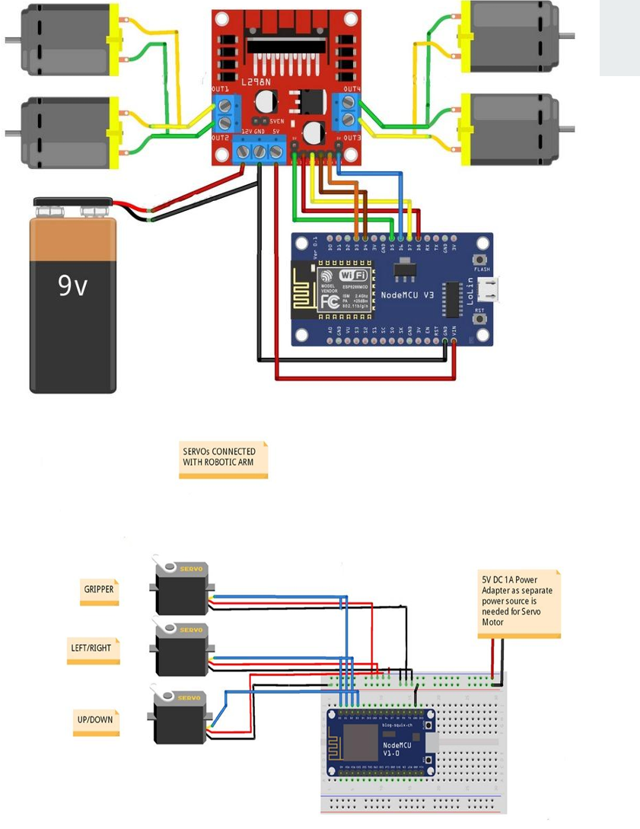
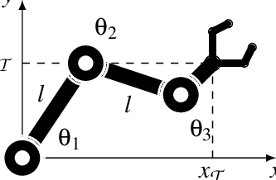
METHODOLOGY
Data Logging & Server Update
Update real-time location and delivery status via the IoT module to the central server.
Store metadata such as time, position, and QR code scan confirmation.
Delivery Confirmation
Re-check delivery success.
If successful, log the event and prepare for the next task.
If unsuccessful, retry or report error to the dispatch center.

Slide 8
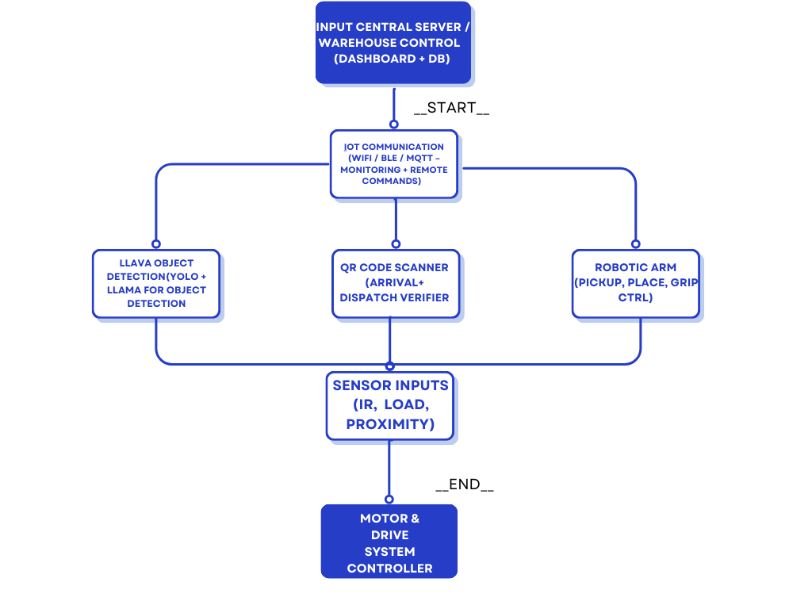
METHODOLOGY
System Initialization
Power up all components: microcontrollers, sensors, robotic arm, and vehicle control systems.
Initialize the IoT communication module and connect to the central dispatch system
Environment Scanning
Use LLaMA (LLaMA-Vision) for real-time detection of packages in the warehouse environment.
Continuously monitor the surroundings for package presence using onboard cameras and sensors.
Navigation & Movement
Autonomous vehicles movement can be controlled by the Blynk IOT application
Employ obstacle avoidance and route optimization techniques.
Robotic Arm Operation
Activate the robotic arm to grip, lift, and place the package securely at the designated location.
Adjust gripping force based on package size and weight.

Slide 9
EXPECTED OUTCOMES
Autonomous Delivery System:
A fully functional delivery vehicle capable of autonomously navigating warehouse environments using sensors and machine learning.
Intelligent Robotic Arm Integration:
Deployment of a precision-controlled robotic arm for gripping, sorting, and placing packages with minimal human involvement.
Real-Time Object Detection and Navigation:
Implementation of the LLama model for high-accuracy, real-time object detection and dynamic path planning.
Edge-to-Cloud Communication:
A robust IoT framework allowing real-time communication between the vehicle and a central monitoring system using MQTT protocols and cloud APIs.
Enhanced Warehouse Efficiency:
Reduction in manual labor, increased safety, and improved productivity in warehouse operations through automation of repetitive and hazardous tasks.

Slide 10
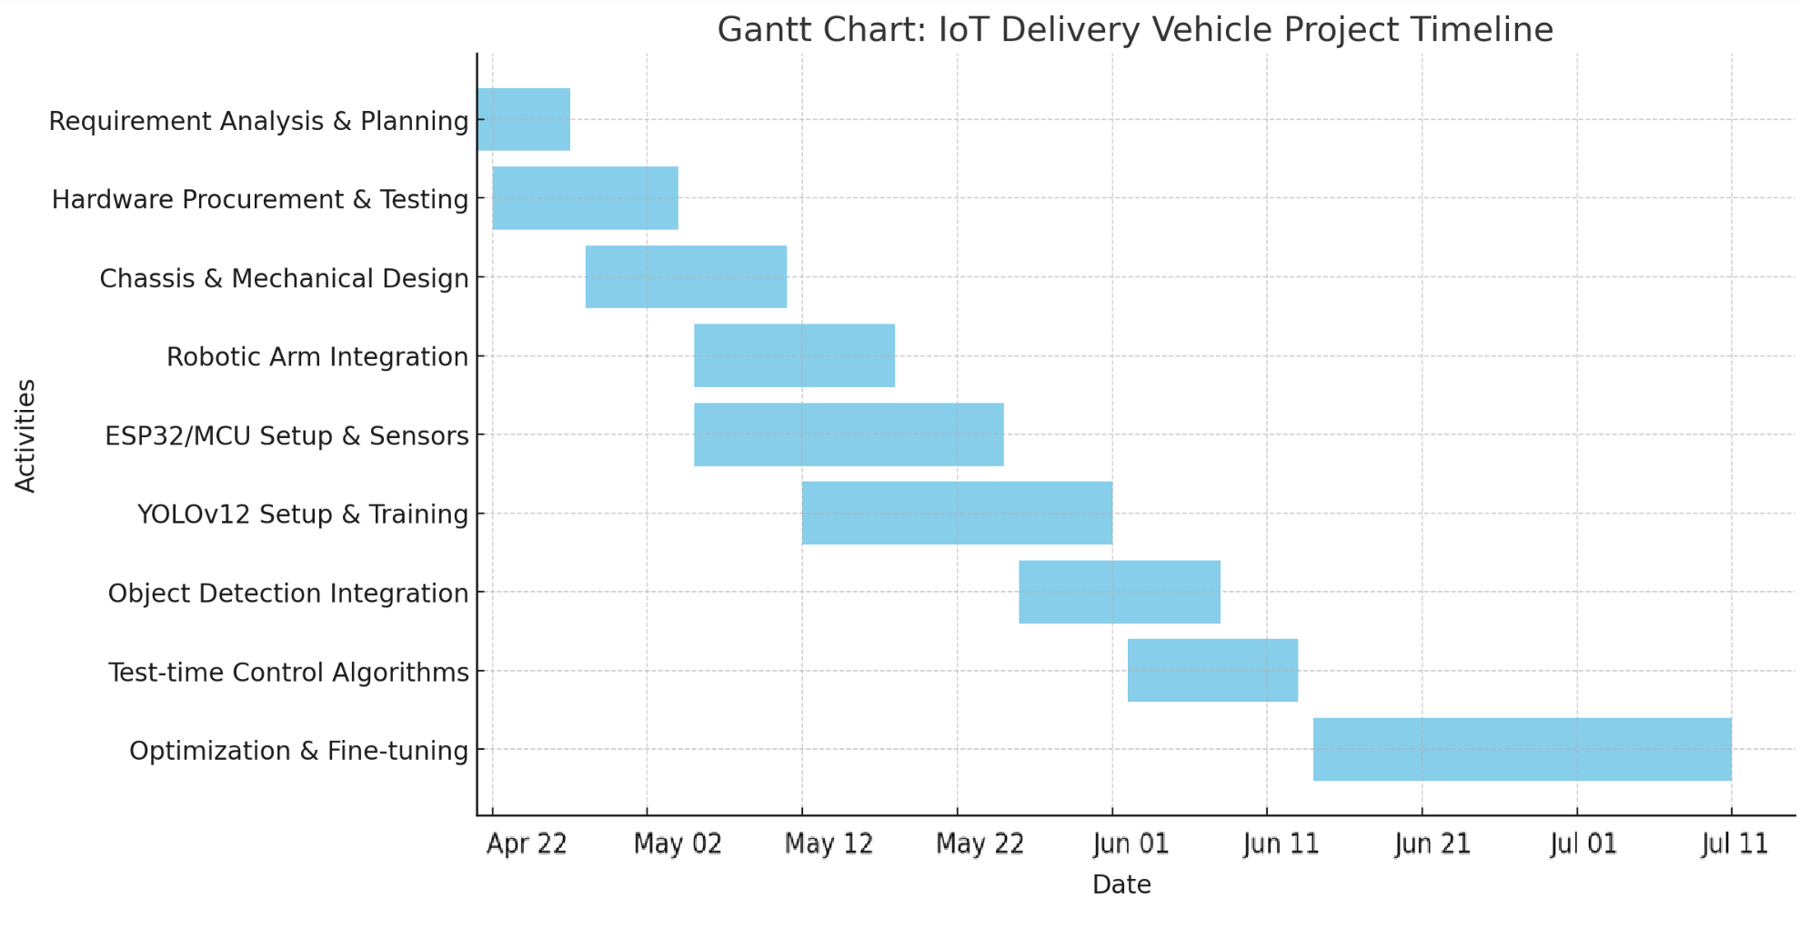
TIMELINE

Slide 11
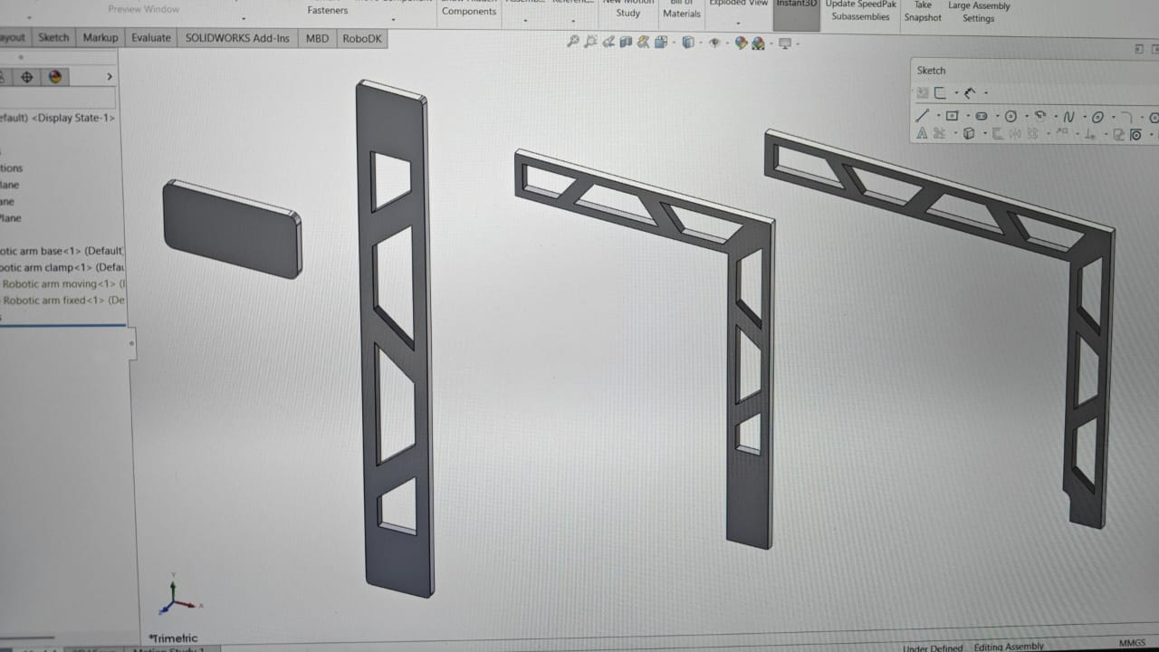
RESULTS
Robotic Arm Design on Ansys to be 3D printed

Slide 12
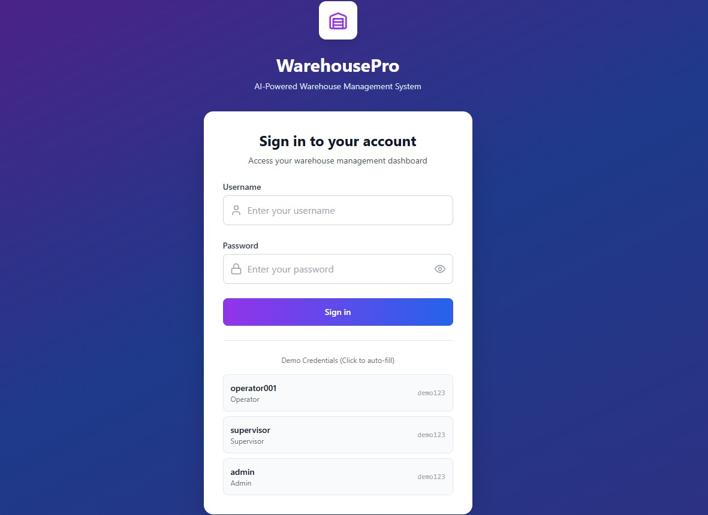
RESULTS
Warehouse Management Login Page

Slide 13
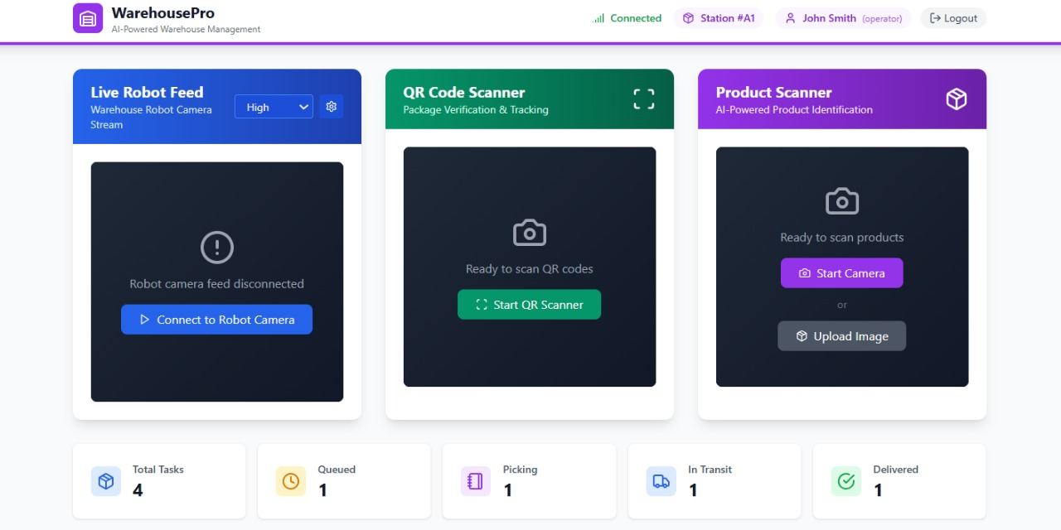
RESULTS
Warehouse maagement IOT interface

Slide 14
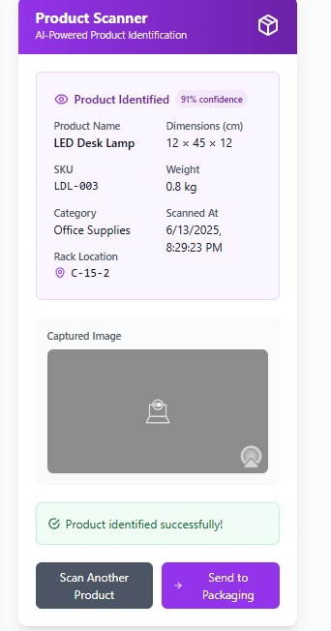
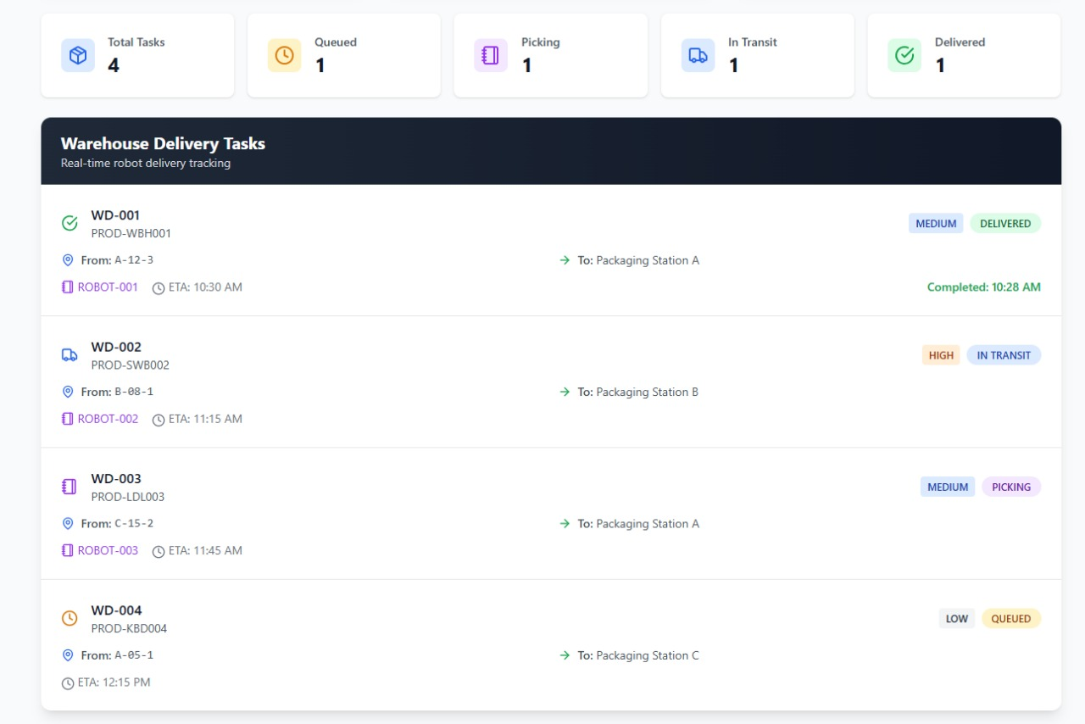
RESULTS
Tasks to be completed, tasks in completion and tasks completed is shown.

Slide 15
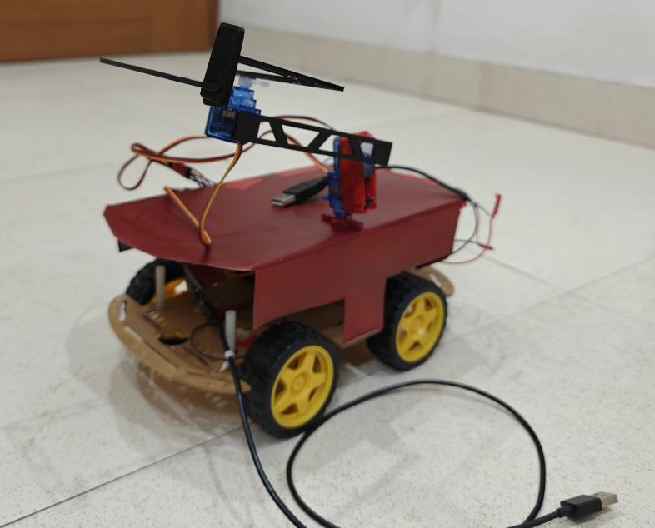
RESULTS
Delivery Vehicle with Robotic arm mounted on top.

Slide 16

QR CODE

Slide 17
CONCLUSION
Successfully developed an autonomous delivery vehicle capable of performing pick-and-place operations using a three-degrees-of-freedom robotic arm.
Achieved reliable object detection with 92% accuracy using a server-hosted LLaMA-4 model integrated with camera vision.
Enabled seamless real-time data synchronization and control through Firebase and a custom web dashboard for remote access.
Demonstrated stable system performance with up to 4 hours of continuous operation per charge under warehouse-like conditions.
Modular three-layer architecture (hardware, software, cloud) ensured easy scalability, maintenance, and robustness.
Proven as a cost-effective, scalable prototype aligned with Industry 4.0 goals for smart, contactless warehouse automation.

Slide 18
REFERENCES
[1] Carducci, Carlo Guarnieri Cal`o, Antonello Monti, Markus Hans Schraven, Markus Schumacher, and Dirk Mueller. ”Enabling ESP32
based IoT applications in building automation systems.” In 2019 II Workshop on Metrology for Industry 4.0 and IoT, pp. 306–311. IEEE, 2019.
[2] Kareem, Husam, and Dmitriy Dunaev. ”The working principles of ESP32 and analytical comparison of using low-cost microcontroller modules in embedded systems design.” In 2021 4th International Conference on Circuits, Systems and Simulation (ICCSS), pp. 130–135. IEEE, 2021.
[3] Dhouioui, Mohamed, and Tarek Frikha. ”Intelligent warehouse management system.” In 2020 IEEE International Conference on Design & Test of Integrated Micro & Nano-Systems (DTS), pp. 1–5. IEEE, 2020.
[4] Subramanian, M., M. Agalya, V. Divya, and R. Harini. ”AI Based Warehouse Management System.” In 2023 Intelligent Computing and Control for Engineering and Business Systems (ICCEBS), pp. 1–5. IEEE, 2023.
[5] Farman, Madiha, Muneera Al-Shaibah, Zoha Aoraiath, and Firas Jarrar. ”Design of a three degrees of freedom robotic arm.” International Journal of Computer Applications, vol. 179, no. 37, pp. 12–17, 2018.
[6] Xie, Jianlin, Guanqun Wang, Tong Zhang, Yikang Sun, He Chen, Yin Zhuang, and Jun Li. ”LLaMA-Unidetector: A LLaMA-Based Universal Framework for Open-Vocabulary Object Detection in Remote Sensing Imagery.” IEEE Transactions on Geoscience and Remote Sensing, 2025.
[7] Elhag, Salma, Alaa Alrfeai, Bashair Aljoudi, and Ekram Alhazmi. ”Warehouse Management and Tracking System for University Assets Using IoT Technology to Optimize Operations and Reduce Randomness.” In 2025 2nd International Conference on Advanced Innovations in Smart Cities (ICAISC), pp. 1–7. IEEE, 2025.
[8] Zhao, Kang, Minghua Zhu, Bo Xiao, Xuguang Yang, Changlei Gong, and Junyi Wu. ”Joint RFID and UWB technologies in intelligent warehousing management system.” IEEE Internet of Things Journal, vol. 7, no. 12, pp. 11640–11655, 2020.
[9] Chen, Shazhou, Wei Meng, Weiyuan Xu, Zhuoqiang Liu, Jiachuang Liu, and Fengyan Wu. ”A warehouse management system with UAV based on digital twin and 5G technologies.” In 2020 7th International Conference on Information, Cybernetics, and Computational Social Systems (ICCSS), pp. 864–869. IEEE, 2020.
[10] Meher, Bimal Kumar, Ruhul Amin, Ashok Kumar Das, and Muhammad Khurram Khan. ”KL-RAP: An efficient key-less RFID authentication protocol based on ECDLP for consumer warehouse management system.” IEEE Transactions on Network Science and Engineering, vol. 9, no. 5, pp. 3411–3420, 2022.

Slide 19
REFERENCES
[11] Kong, Lin, Adilijiang Kurexi, Jiang Zhang, Huan Guo, and Hongji Luo. ”Design and Application of Intelligent Warehouse Management System Based on RFID and Image Recognition Technology.” In 2024 IEEE 6th International Conference on Civil Aviation Safety and Information Technology (ICCASIT), pp. 219–223. IEEE, 2024.
[12] Nicholson, John, Jay Jasper, Ara Kourchians, Greg McCutcheon, Max Austin, Mark Gonzalez, Jason Pusey, Sisir Karumanchi, Christian Hu bicki, and Jonathan Clark. ”Llama: Design and control of an omnidi rectional human mission scale quadrupedal robot.” In 2020 IEEE/RSJ International Conference on Intelligent Robots and Systems (IROS), pp. 3951–3958. IEEE, 2020.
[13] Holiel, Heidi Ahmed, Sahar Ali Fawzi, and Walid Al-Atabany. ”As sisting Visually Impaired Subjects Using Large Language Models: A Comprehensive Evaluation.” In 2024 6th Novel Intelligent and Leading Emerging Sciences Conference (NILES), pp. 561–566. IEEE, 2024.
[14] K¨ om¨ urc¨u, K¨ urs ¸at, and Linas Petkeviˇ cius. ”MiniCPM-V LLaMA Model for Image Recognition: A Case Study on Satellite Datasets.” IEEE Journal of Selected Topics in Applied Earth Observations and Remote Sensing, 2025.
[15] Song, Ha Yoon, and Hyochang Han. ”An adaptation of IoT to improve parcel delivery system.” In 2019 Federated Conference on Computer Science and Information Systems (FedCSIS), pp. 497–500. IEEE, 2019.
[16] Liang, Xinquan, Haris Cheong, Yi Sun, Jin Guo, Chee Kong Chui, and Chen-Hua Yeow. ”Design, characterization, and implementation of a two-DOF fabric-based soft robotic arm.” IEEE Robotics and Automation Letters, vol. 3, no. 3, pp. 2702–2709, 2018

Slide 20


